Slide 1

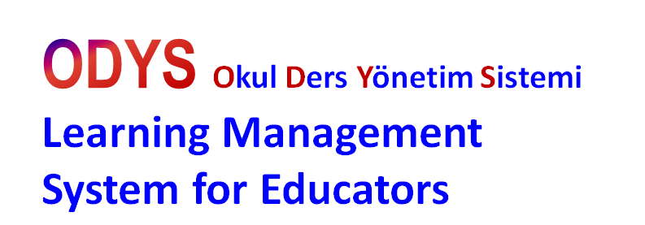

Web Based
Rich Content
Preperation Platform.

Slide 2
Gündem
Our Team
About Us
Education Cloud
What is WebSunum?
WebSunum–Smart Editor
Targeted Market

Slide 3


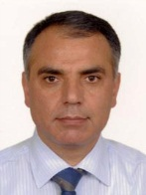
Project Team
Integration of different backgrounds and expertises!
Hasan Özer
Math Engineer and Teacher, Founder of Ozer Digital Education Publishing. Three decades on educational publication and leader on his area.
Dr. Zekai Ötleş
Engineering backgrund and over two decades of experience in software production.
Ünal Mecit
Engineer, expertise in software development cycle and held IT Director position to in a multinational companies.

Slide 4
Hakkımızda
Özer Digital Educational Publishing
It is a leader on digital and paper publishing. Ozer publishing has lead and contributed to Turkish education system since 1982. The company funded by TUBITAK and awarded by many innovations grants by KOSGEB and ITU Ari Teknokent. Those contributions made the Ozer publishing to lead and exist in a Digital Publishing.
Our Vision
Contribute to education system in Domestics and Global level. Help our country and world to advance education to next level, which required by Information Age, with our educational software technologies.

Slide 5

WebSunum …is a part of Educational Cloud
Webegitim.net
eLearning
Websunum
.net
eBulut.com
Social Media
For Education
Egitimizi.com
timeline
Dersveral.com
Math Club
Education TV
Educational e-Store
Yazokulu.com
SummerSchool
gazeteokul.com
haberokul.com
Digital Library for Ozer Publishing

Slide 6


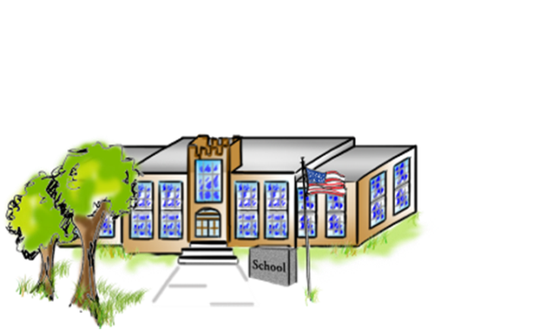









WebSunum – Componenets
WEB BASED EDUCATIONAL CONTENT PREPERATION SYSTEM
WebSunum
CloudComputing Based
WebSunum Enterprise
Educational Cloud
www.eBulut.com
School- Institution
Independed Enterprise Version for Instutions
(Intranet)
ODYS- Learning Management System
SCHOOL/ Student
TEACHER
Digital Content Library
SmartBoard
Tablet
PC
WebSunum
Smart Editor

Slide 7

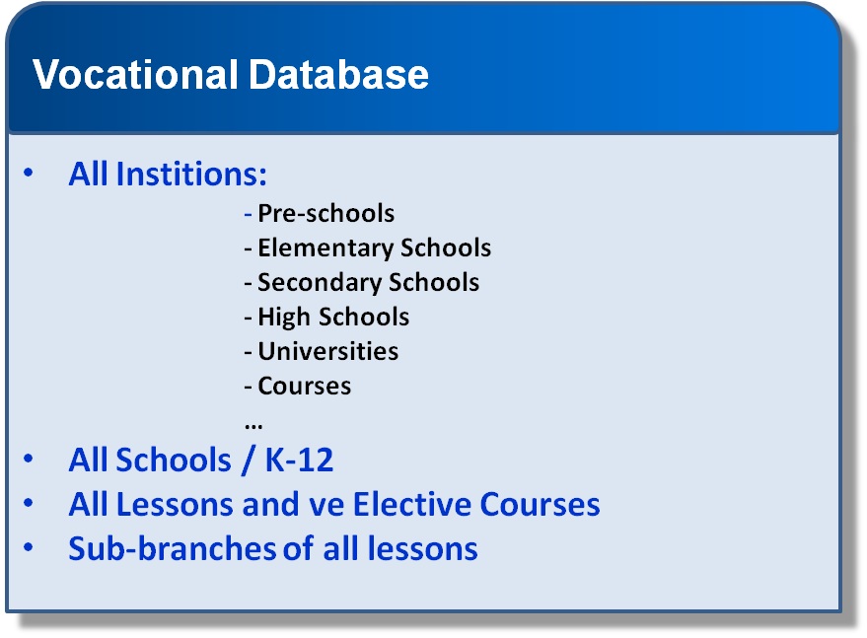
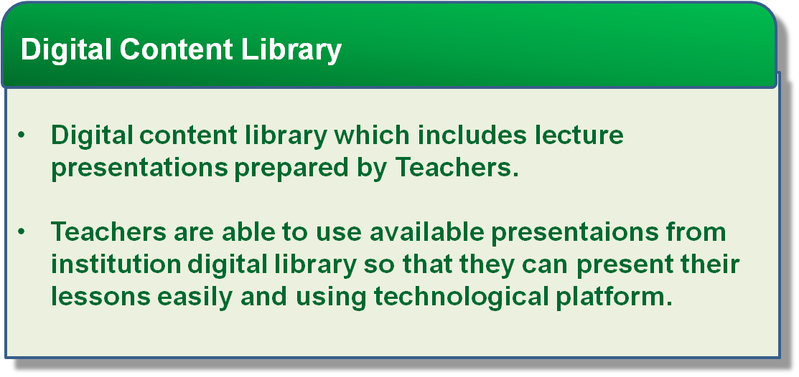


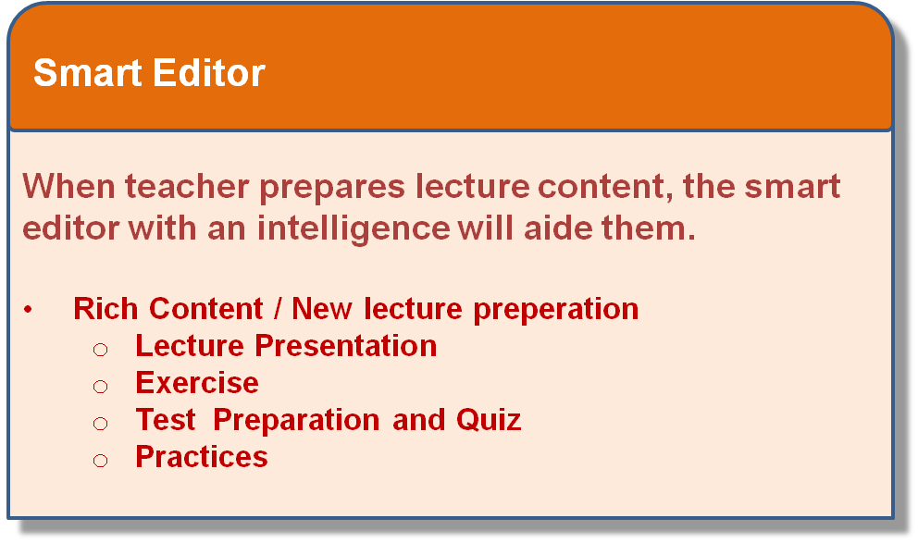


Main Functions
WEB BASED EDUCATIONAL CONTENT PREPERATION SYSTEM

Slide 8


WebSunum
WEB BASED EDUCATIONAL CONTENT PREPERATION SYSTEM
Websunum is a web based interactive software tool for educators in which they can easily and quickly create and manage their rich content lecture presentations^{(*)}.
Works on both cloud based and Intranet systems of enterprise.
Vocational Database is a one of important part of Websunum.
Lecture Presentations can prepared easily and quickly using Smart Editor.
Prepared Lecture presantation can be added automatically to Digital Content Library.
Educators can easily collaborate and reach in every platform.
(*) Lecture Presentation,Exercises , Tests , Practices Quiz,,,

Slide 9


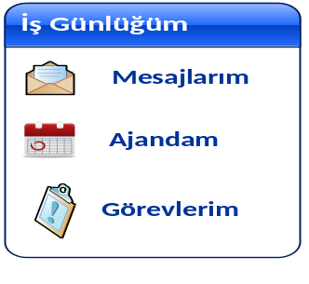


Moduls
WEB BASED EDUCATIONAL CONTENT PREPERATION SYSTEM
Acoount Management
Create and account, subscribe to product online .
ODYS- Institution Management System
Yearly Plan and Tasks for Educators.
Daily Task Management
When sign-on the system, Teachers can manage their daily tasks, calenders and internal ma,ils.
Digital Library
Archive Management,
Teachers can use or rewiev available lecture presentations.
Smart Editor
Create new lecture presen. or update the existing one.
Quality Managemet
Team Lead Control of Presentations , Measurement and Evaluation, Rating

Slide 10
WebSunum / Smart Editor
WEB BASED EDUCATIONAL CONTENT PREPERATION SYSTEM
Smart Editör ; The most important part of WebSunum
Guides to Teachers.
Manage Time. Time is key factor for educators.
Automatically recognise the sub branch of content
Based on established algorithms brings the elements of visual design toolset creates and provides to the user automatic filtering and templates.

Slide 11
Targeted Market
WEB BASED EDUCATIONAL CONTENT PREPERATION SYSTEM
Domestics Target
Short Term: Private Schools and Goverment Schools where FATİH project are implemented.
Mid Term : All Goverment schools in the scope of Fatih Project , Private Schools and Universities.
International Target
Mid Term : Middl East , Asia, South Kore and North Europe countries in which they are closely interested in FATİH project.
Long Term : Worldwide

Slide 12
Financial Target
WEB BASED EDUCATIONAL CONTENT PREPERATION SYSTEM
Short Term (1-2 years):
1.000 Schools (goverment and private schools + universities) 25.000 educators
Turnover /end 2nd year : 875.000 US$ + TAX
  (35 $ + Tax / user)
Mid Term (3rd year):
1.430 Schools (goverment and private schools + universities) 38.000 educators
Turnover /year : 1.520.000 US$ + Tax
  (40 $ + Tax / User )
Licensing is done based on user /year membership.
Considered only Product Sales ; Service , Training and Implementation Charges are plus.
International Sales is not considered for above turnovers.

Slide 13

Thank you very much
for your attention…
Hasan Özer
Ünal Mecit
Zekai Ötleş
Özer Dijital Eğitim Yayınları
Kocasinan Merkez Mah. Kuşçu Sokak
No: 1 / B Blok - E Yenibosna / İSTANBUL
info@ozeryayinlari.com.tr
Telefon : 0212 513 37 70 - 71
0212 489 04 20

